Slide 1
Sequential Cirucits

Slide 2
Class 19 – Sequential Circuits
Definitions
Latches
  Set-Reset – SR
  The D Latch
Material from section 5-1 and 5-2 of text

Slide 3
Combination Logic
Logic that performs some transformation operation on the inputs to produce outputs which are simple logic functions of the input.
The outputs reflect a function of the current values on the inputs.
There is not the capability to hold the value of the input.

Slide 4
Sequential Logic
Logic elements capable of storing a logic value.
Sequential circuits are those circuits that employ these elements.
Will be looking at the methodologies for sequential circuit design.

Slide 5
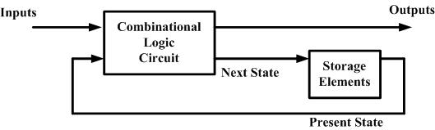
Basic structure
The basic structure of a synchronous sequential circuit is shown here.
Synchronous – One input is a clock and on the clock the next state becomes the present state of the system.
Sequential – The circuit transitions between states in a regular manner.

Slide 6
Definitions
Inputs – All the outside logic signal inputs to the circuit. Typically, the clock is not consider part of the signal inputs of the circuit.
Outputs – The logic signal outputs.
Present State – the logic value of all the state variables of the system. These are stored in the state memory.
Next State – Given the present state and the current values on the inputs, the next state represents the next logic state the circuit will transition to on the next clock.

Slide 7
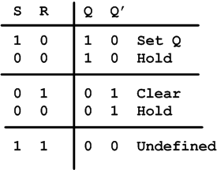
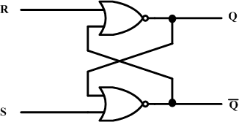
The SR Latch
The SR (Set-Reset) Latch
And its operation

Slide 8
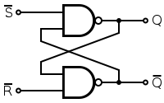
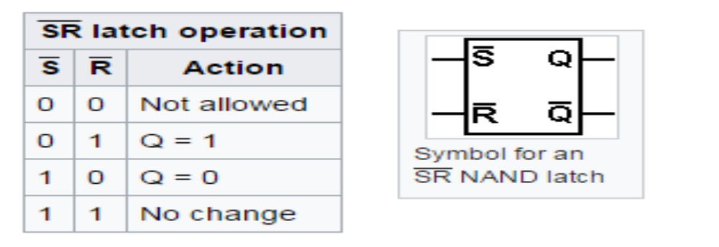
SR NAND Latch:

Slide 9
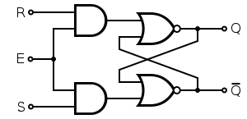
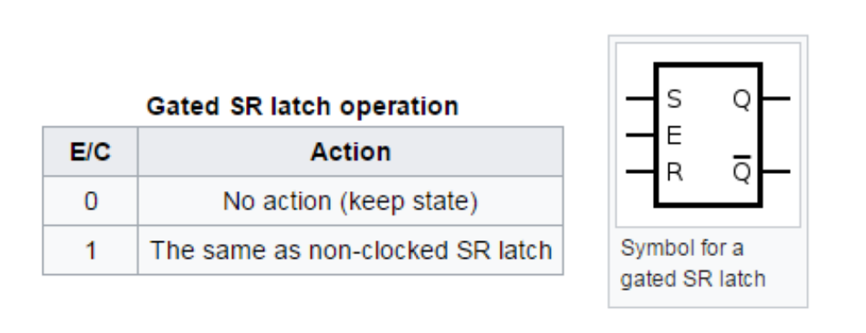
Gated SR latch:
9/15/09 - L19 Sequential Circuits
Copyright 2009 - Joanne DeGroat, ECE, OSU

Slide 10
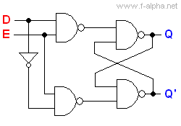
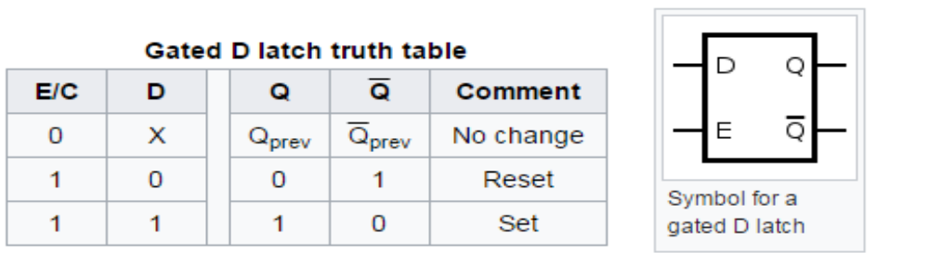
Gated D latch:
9/15/09 - L19 Sequential Circuits
Copyright 2009 - Joanne DeGroat, ECE, OSU

Slide 11
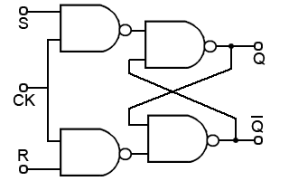
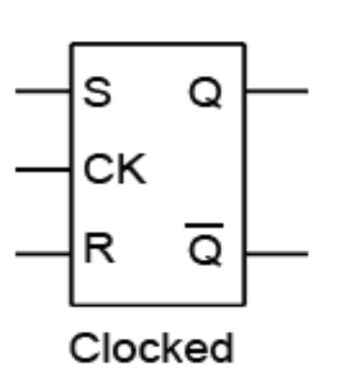
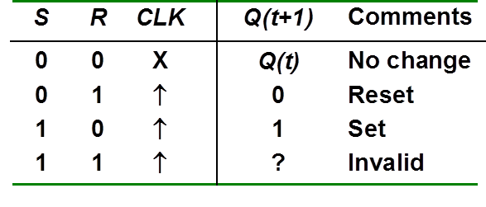
SR Flip Flop:
9/15/09 - L19 Sequential Circuits

Slide 12
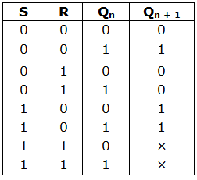
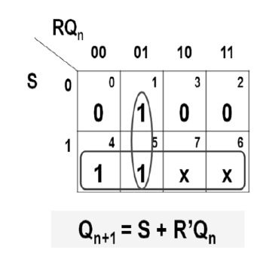
SR Flip Flop Characterstic table:

Slide 13
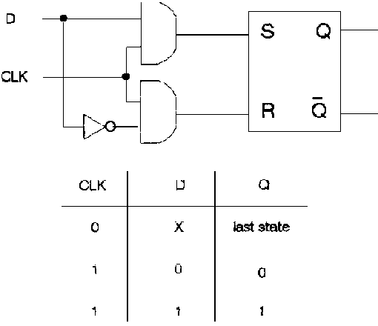
D Flip Flop:
9/15/09 - L19 Sequential Circuits
Copyright 2009 - Joanne DeGroat, ECE, OSU

Slide 14
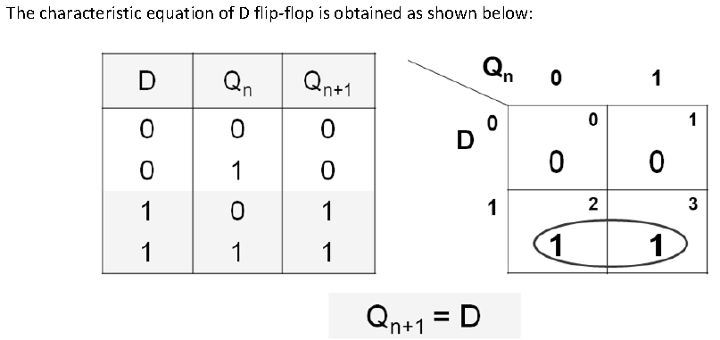
D Flip Flop Characterstic table:

Slide 15
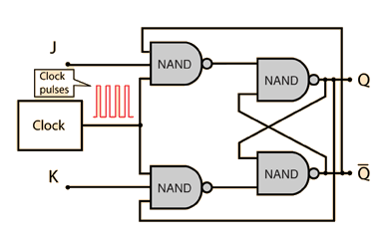
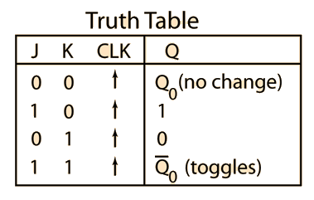
JK Flip Flop
Copyright 2009 - Joanne DeGroat, ECE, OSU

Slide 16
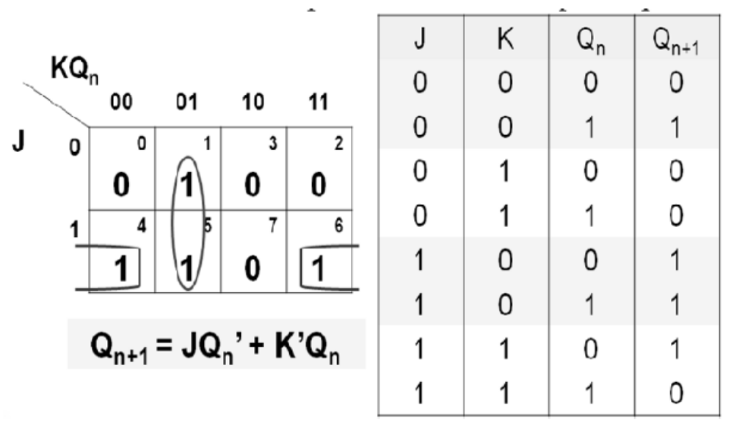
JK Flip Flop Characterstic table

Slide 17

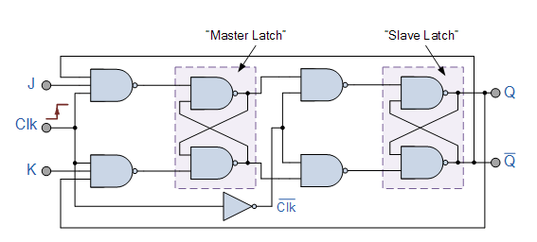
Master slave JK flip flop

Slide 18
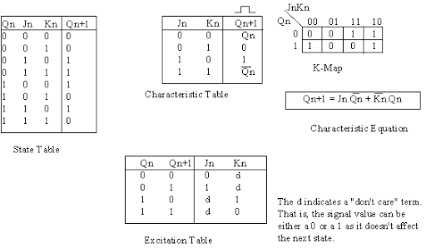

Slide 19
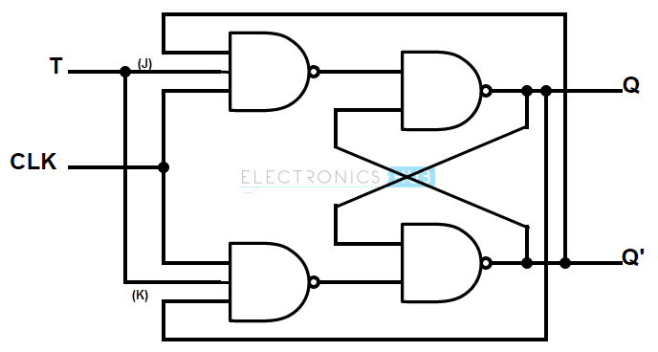
T Flip Flop

Slide 20
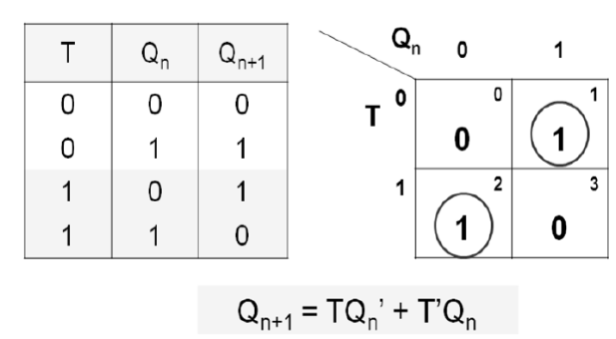
T Flip Flop Characterstic table

